Slide 1
Level by Level
Introduction to ZKP
Presented by Jason
Date: Aug. 27, 2023

Slide 2
Agenda
(2 mins) ZKP Applications
(20 mins) Ali Baba’s Cave: ZKP in High Level
(2 mins) ZKP History
(20 mins) Schnorr’s protocol: Simplest ZKP Example
(10 mins) Discussion 1 & 2
(30 mins) zk-SNARK: Preprocess
(5 mins) Discussion 3
(20 mins) zk-SNARK: Proof Generation & Verification
(5 mis) Groth16: Brief Comparison
Notes:
ZKRP for“zero-knowledge range proof”

Slide 3
Privacy
As an informal definition, ZKP allow one party (the prover) to demonstrate the truth of a statement to another party (the verifier) without revealing any additional information apart from the fact that the statement is true.
Use-cases include anonymous payments, DIDs, Over 18 ZKRP, electronic voting, etc.
Note that ZKP are proofs of “knowledge”, not proofs of truth.
Notes:
ZKRP for“zero-knowledge range proof”

Slide 4
Scaling
There are different solutions for scaling.
On-chain solutions require extensive modification of the blockchain’s base layer.
Off-chain solutions rely on an outsourced computation model to improve throughput, and Ethereum only needs to apply the computation results to its state.
In the off-chain scheme, ZKP can assist with validating off-chain transactions without re-executing them.
A famous example is zk-SNARK.

Slide 5
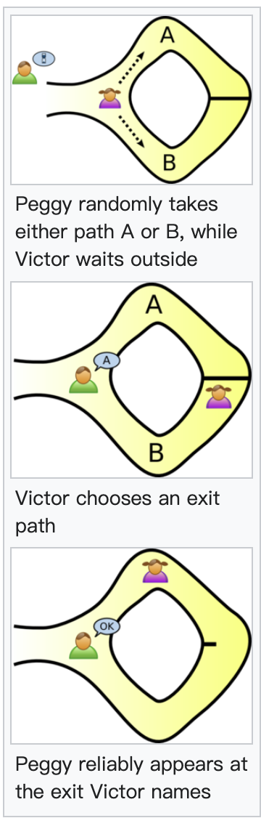
Ali Baba’s Cave
If Peggy knows the magic word, she can always success.
If Peggy doesn’t know the secret word, she will fail after many trails.
Victor can never know the secret word.

Slide 6
ZKP Property
A ZK protocol must satisfy the following criteria:
Completeness: If the prover has proper knowledge, his proof can be accepted by the verifier.
Soundness: If the prover has no proper knowledge, his proof can not be accepted by the verifier.
Zero-knowledge: The proof reveal nothing more than “this statement is true”.

Slide 7

ZKP Property
A ZK protocol must satisfy the following criteria:
Completeness: If the prover has proper knowledge, his proof can be accepted by the verifier.
Soundness: If the prover has no proper knowledge, his proof can not be accepted by the verifier.
Zero-knowledge: The proof reveal nothing more than “this statement is true”.
$$symmetric$$

Slide 8

ZKP Property
A ZK protocol must satisfy the following criteria:
Completeness: If the prover has proper knowledge, his proof can be accepted by the verifier.
Soundness: If the prover has no proper knowledge, his proof can not be accepted by the verifier.
Zero-knowledge: The proof reveal nothing more than “this statement is true”.
$$symmetric$$

Slide 9
ZKP Property
A ZK protocol must satisfy the following criteria:
Completeness: If the prover has proper knowledge, his proof can be accepted by the verifier.
Soundness: Protect the verifier from being cheated.
Zero-knowledge: Protect the prover from information leakage.
$$symmetric$$
→ trust issue → scaling issue
→ privacy issue

Slide 10
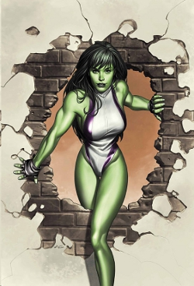
Ali Baba’s Cave – What If... ?
Peggy is She-Hulk?
We can prove the zero-knowledgeness.

Slide 11

Ali Baba’s Cave – What If Else... ?
Victor is Daredevil?
We can prove the soundness.

Slide 12
Ali Baba’s Cave – What Else... ?
Peggy just goes in through A and comes out from B?
The 3rd party will be sure about Peggy’s knowledge.

Slide 13
Interactive vs. Non-Interactive
“Interactive” means interacting more than once.
“Non-interactive” means interacting only once.
Usually we write it as NIZK.
zk-SNARKs = Zero-Knowledge Succinct Non-Interactive Argument of Knowledge

Slide 14
History
In 1985, the concept of IP and ZK appeared.
The Knowledge Complexity of Interactive Proof-System
In 1990, Schnorr’s protocol was proposed.
Efficient Identification and Signatures for Smart Cards
In 2007, a prover in polynomial time was presented.
Delegating Computation: Interactive Proofs for Muggles
In 2010, the concept of verifiable computation was introduced.
Non-Interactive Verifiable Computing: Outsourcing Computation to Untrusted Workers
In 2013, the ZK theories finally became practical!
Quadratic Span Programs and Succinct NIZKs without PCPs
Pinocchio: Nearly Practical Verifiable Computation
Succinct Non-Interactive Zero Knowledge for a von Neumann Architecture

Slide 15



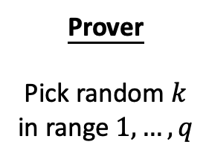
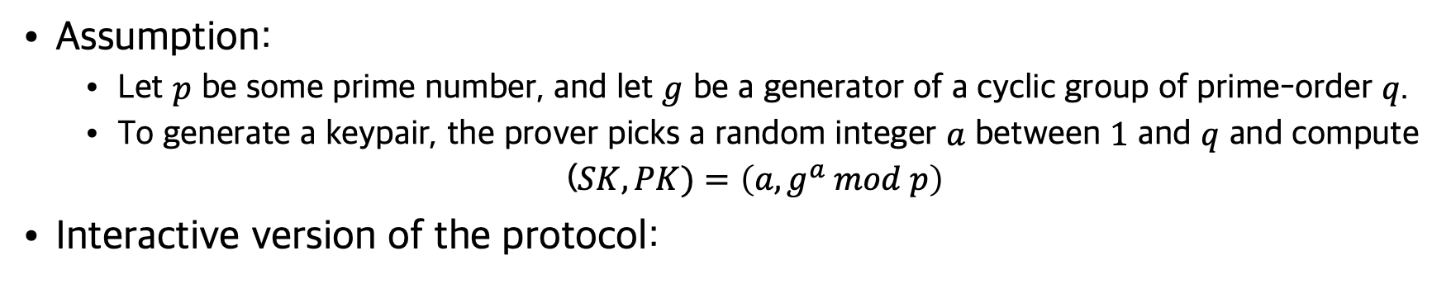

Schnorr’s Protocol
Assumption:
Let $p$ be some prime number, and let $g$ be a generator of a cyclic group of prime-order $q$.
To generate a keypair, the prover picks a random integer $a$ between $1$ and $q$ and compute
($SK, PK)=\left(a, g^{a} mod p\right)$
Interactive version of the protocol:
Prover
Pick random $k$
in range $1,…,q$
Verifier
Pick random $c$
in range $1,…,q$
Check that:
$$g^{z}≡_{p}{PK}^{c}∙h$$
$${h=g}^{k }mod p$$
$$c$$
$$z=ac+k mod q$$

Slide 16
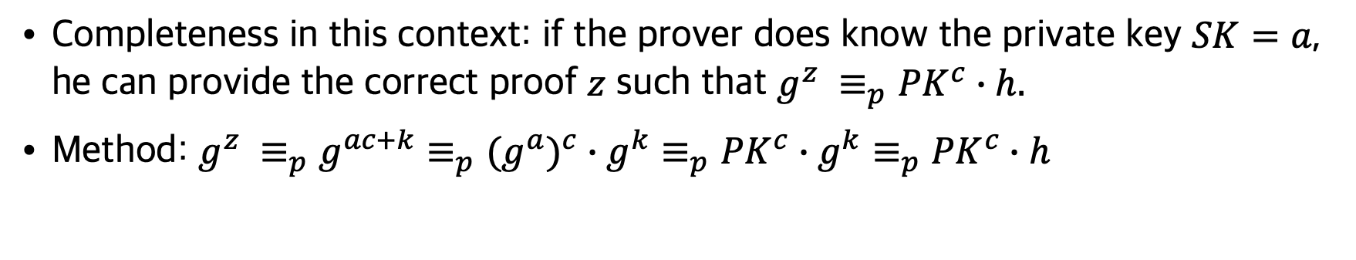
Proving the Completeness
Completeness in this context: if the prover does know the private key $SK=a$, he can provide the correct proof $z$ such that $g^{z} ≡_{p}{PK}^{c}∙h.$
Method: $g^{z} {≡_{p}g}^{ac+k}≡_{p}(g^{a})^{c}∙g^{k}≡_{p}{PK}^{c}∙g^{k}≡_{p}{PK}^{c}∙h$
Prover
Pick random $k$
in range $1,…,q$
Verifier
Pick random $c$
in range $1,…,q$
Check that:
$$g^{z}≡_{p}{PK}^{c}∙h$$
$${h=g}^{k }mod p$$
$$c$$
$$z=ac+k mod q$$

Slide 17




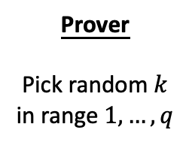



Proving the Soundness
Soundness in this context: if the prover doesn’t know the private key $SK=a$, he cannot provide the correct proof $z$ such that $g^{z} ≡_{p}{PK}^{c}∙h.$
Method: use an extractor (i.e. Daredevil) to recover the prover’s knowledge.
Prover
Pick random $k$
in range $1,…,q$
Verifier
Pick different random
$c_{1},c_{2}$ in range $1,…,q$
Extract the secret by
$$a≡_{q}(z_{1}−z_{2})/ (c_{1}−c_{2})$$
$${h=g}^{k }mod p$$
$$c_{1}$$
$$z_{1}=a(c_{1})+k mod q$$
Rewinds to Step2
$$c_{2}$$
$$z_{2}=a(c_{2})+k mod q$$
Notes:
This scheme is used in real world attack, when the randomness in the cryptography algorithm is violated.

Slide 18



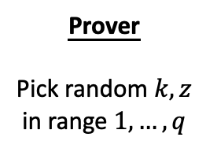

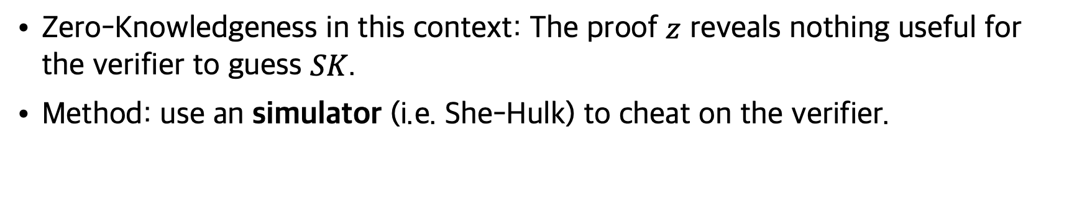

Proving the Zero-Knowledge(ness)
Zero-Knowledgeness in this context: The proof $z$ reveals nothing useful for the verifier to guess $SK$.
Method: use an simulator (i.e. She-Hulk) to cheat on the verifier.
Prover
Pick random $k, z$
in range $1,…,q$
Verifier
Pick random $c$
in range $1,…,q$
Check that:
$$g^{z}≡_{p}{PK}^{c}∙h′$$
$${h=g}^{k }mod p$$
$$c$$
Rewinds to Step1
$${h′=g}^{z}∙g^{a(−c)} mod p$$
$$c$$
$$z$$
$${PK}^{c}∙h^{′}≡_{p}{PK}^{c}∙g^{z}∙g^{a(−c)}≡_{p}(g^{a})^{c}∙g^{z}∙g^{a(−c)}{≡_{p}g}^{z}$$
Notes:
If the simulator succeed, we therefore prove that the proof must contain no knowledge, since the simulator itself does not have the knowledge.

Slide 19

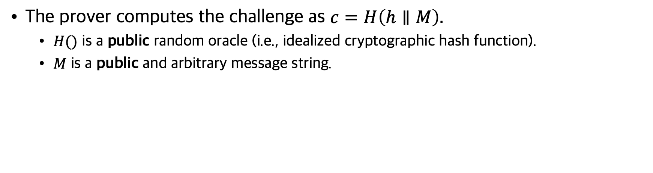

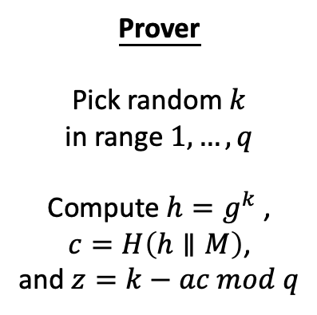
Non-Interactive Version
The prover computes the challenge as $c=H\left(h∥M\right).$
$H()$ is a public random oracle (i.e., idealized cryptographic hash function).
$M$ is a public and arbitrary message string.
Prover
Pick random $k$
in range $1,…,q$
Compute $h=g^{k}$ ,
$$c=H\left(h∥M\right)\text{,}$$
and $z=k−ac mod q$
Verifier
Compute
$$h≡_{p}{PK}^{c}∙g^{z}$$
Check that:
$$c=H\left(h∥M\right)$$
$$(c, z)$$
$${h≡_{p}g^{k} ≡}_{p}{{(g^{a})^{c}∙g}^{k−ac} ≡}_{p}{{(g^{a})^{c}∙g}^{z} ≡}_{p}{PK}^{c}∙g^{z}$$

Slide 20
Discussion 1
Schnorr’s protocol is actually a signing scheme for message 𝑀.
What’s the relationship between signature and NIZK?
Prover
Pick random $k$
in range $1,…,q$
Compute $h=g^{k}$ ,
$$c=H\left(h∥M\right)\text{,}$$
and $z=k−ac mod q$
Verifier
Compute
$$h≡_{p}{PK}^{c}∙g^{z}$$
Check that:
$$c=H\left(h∥M\right)$$
$$(c, z)$$
$${h≡_{p}g^{k} ≡}_{p}{{(g^{a})^{c}∙g}^{k−ac} ≡}_{p}{{(g^{a})^{c}∙g}^{z} ≡}_{p}{PK}^{c}∙g^{z}$$

Slide 21
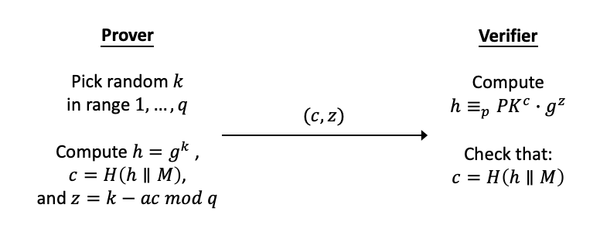
Discussion 2
Why should the verifier trust the prover in these scenarios?
Ali Baba’s Cave
Schnorr’s protocol (NI version)
Possible sources of trust:
Interaction
Random Oracle
Common Reference String (CRS)
Trusted Setup

Slide 22
What is zk-SNARK?
SNARK: Succinct Non-Interactive Argument of Knowledge
zk-SNARK is a general technique, and there are many protocol to implement it:
Pinocchio Protocol
Groth16
PLONK (Permutations over Lagrange-bases for Oecumenical Noninteractive arguments of Knowledge)
Bulletproofs
STARK
...

Slide 23
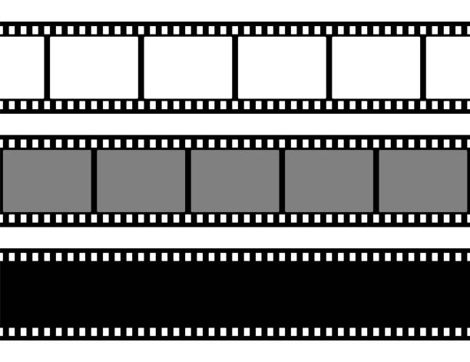
Intuitively
... * 424 * 391*18 * 772 * 734 * ... mod m
?= some value based on trusted setup
424
391
018
772
734
... * ___ * 444 * 508 * 337 * 932 * ... mod m
?= some value based on trusted setup
004
111
508
337
932
???
???
???
???
???

Slide 24
Pinocchio Protocol (PGHR13)
The prover converts the computation into quadratic arithmetic program (QAP), and at the same time calculates a corresponding witness.
The prover generates a proof, which consists of 8 elliptic curve (EC) points, by doing some EC operations on the QAP and the witness, with the CRS acquired though trusted setup.
The verifier verifies the proof by leveraging knowledge of coefficient / exponent (KoC/KoE).

Slide 25
Pinocchio Protocol: Preprocess
The prover converts the computation into quadratic arithmetic program (QAP), and at the same time calculates a corresponding witness.
The prover generates a proof, which consists of 8 elliptic curve (EC) points, by doing some EC operations on the QAP and the witness, with the CRS acquired though trusted setup.
The verifier verifies the proof by leveraging knowledge of coefficient / exponent (KoC/KoE).

Slide 26
Computation to QAP
Computation
Algebraic Circuit
R1CS (rank-1 constraints)
QAP

Slide 27
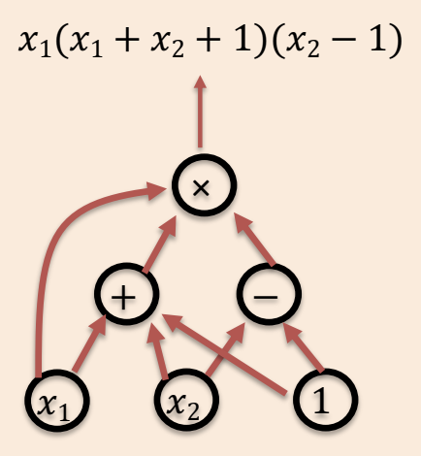
Computation to Algebraic Circuit
def qeval(x):
y = x**3
return x + y + 5
sym_1 = x * x
y = sym_1 * x
sym_2 = (x + y) * 1
~out = (sym_2 + 5) * 1
Graphical example for circuit

Slide 28
Circuit to R1CS
sym_1 = x * x
y = sym_1 * x
sym_2 = (x + y) * 1
~out = (sym_2 + 5) * 1
ω = [1, 3, 35, 9, 27, 30]
This is the witness for proving qeval(3) = 35, with the first three values being public input.
i 1 2 3 4 5 6
i 1 2 3 4 5 6
i 1 2 3 4 5 6
j
1
2
3
4
‘~one’, ‘x’, ‘~out’, ‘sym_1’, ‘y’, ‘sym_2’
‘~one’, ‘x’, ‘~out’, ‘sym_1’, ‘y’, ‘sym_2’
‘~one’, ‘x’, ‘~out’, ‘sym_1’, ‘y’, ‘sym_2’
[0, 0, 0, 1, 0, 0]
=
[0, 1, 0, 0, 0, 0]
*
[0, 1, 0, 0, 0, 0]
[0, 0, 0, 0, 1, 0]
=
[0, 0, 0, 1, 0, 0]
*
[0, 1, 0, 0, 0, 0]
[0, 0, 0, 0, 0, 1]
=
[0, 1, 0, 0, 1, 0]
*
[1, 0, 0, 0, 0, 0]
[0, 0, 1, 0, 0, 0]
=
[5, 0, 0, 0, 0, 1]
*
[1, 0, 0, 0, 0, 0]

Slide 29
Circuit to R1CS
ω = [1, 3, 35, 9, 27, 30]
C5 = -6 + 9.5j - 4j^2 + 0.5j^3
= ·
[ j^0, j^1, j^2, j^3]
A5 = 4 - 7j + 3.5j^2 – 0.5j^3
= ·
[j^0, j^1, j^2, j^3]
B5 = 0 - 0j + 0j^2 – 0j^3
= ·
[j^0, j^1, j^2, j^3]
[-6.0, 9.5, -4.0, 0.5]
[4.0, -7.0, 3.5, -0.5]
[0.0, 0.0, 0.0, 0.0]
i 1 2 3 4 5 6
i 1 2 3 4 5 6
i 1 2 3 4 5 6
j
1
2
3
4
j
1
2
3
4
j
1
2
3
4
‘~one’, ‘x’, ‘~out’, ‘sym_1’, ‘y’, ‘sym_2’
‘~one’, ‘x’, ‘~out’, ‘sym_1’, ‘y’, ‘sym_2’
‘~one’, ‘x’, ‘~out’, ‘sym_1’, ‘y’, ‘sym_2’
[0, 0, 0, 1, 0, 0]
=
[0, 1, 0, 0, 0, 0]
*
[0, 1, 0, 0, 0, 0]
[0, 0, 0, 0, 1, 0]
=
[0, 0, 0, 1, 0, 0]
*
[0, 1, 0, 0, 0, 0]
[0, 0, 0, 0, 0, 1]
=
[0, 1, 0, 0, 1, 0]
*
[1, 0, 0, 0, 0, 0]
[0, 0, 1, 0, 0, 0]
=
[5, 0, 0, 0, 0, 1]
*
[1, 0, 0, 0, 0, 0]

Slide 30
R1CS to QAP
ω = [1, 3, 35, 9, 27, 30]
C
A
B
[0.0, 0.0, 0.0, 0.0]
[0.0, 0.0, 0.0, 0.0]
[-1.0, 1.833, -1.0, 0.166]
[4.0, -4.333, 1.5, -0.166]
[4.0, -7.0, 3.5, -0.5]
[-5.0, 9.166, -5.0, 0.833]
[8.0, -11.333, 5.0, -0.666]
[0.0, 0.0, 0.0, 0.0]
[-6.0, 9.5, -4.0, 0.5]
[-1.0, 1.833, -1.0, 0.166]
[3.0, -5.166, 2.5, -0.333]
[-2.0, 5.166, -2.5, 0.333]
[0.0, 0.0, 0.0, 0.0]
[0.0, 0.0, 0.0, 0.0]
[0.0, 0.0, 0.0, 0.0]
i 1 2 3 4 5 6
i 1 2 3 4 5 6
i 1 2 3 4 5 6
[-6.0, 9.5, -4.0, 0.5]
[4.0, -7.0, 3.5, -0.5]
[0.0, 0.0, 0.0, 0.0]

Slide 31
Checking the QAP
For j = 1,2,3,4, A·ω(j) * B·ω(j) - C·ω(j)= 0
[-41, 71.666, -24.5, 2.833]
[43, -73.333, 38.5, -5.166]
[-3, 10.333, -5, 0.666]
C
·ω
A
·ω
B
·ω
[0.0, 0.0, 0.0, 0.0]
[0.0, 0.0, 0.0, 0.0]
[-1.0, 1.833, -1.0, 0.166]
[4.0, -4.333, 1.5, -0.166]
[4.0, -7.0, 3.5, -0.5]
[-5.0, 9.166, -5.0, 0.833]
[8.0, -11.333, 5.0, -0.666]
[0.0, 0.0, 0.0, 0.0]
[-6.0, 9.5, -4.0, 0.5]
[-1.0, 1.833, -1.0, 0.166]
[3.0, -5.166, 2.5, -0.333]
[-2.0, 5.166, -2.5, 0.333]
[0.0, 0.0, 0.0, 0.0]
[0.0, 0.0, 0.0, 0.0]
[0.0, 0.0, 0.0, 0.0]
ω = [1, 3, 35, 9, 27, 30]
i 1 2 3 4 5 6
i 1 2 3 4 5 6
i 1 2 3 4 5 6
[-6.0, 9.5, -4.0, 0.5]
[4.0, -7.0, 3.5, -0.5]
[0.0, 0.0, 0.0, 0.0]

Slide 32
Checking the QAP
For j = 1,2,3,4, A·ω(j) * B·ω(j) - C·ω(j) = 0
Let Z = (j-1) * (j-2) * (j-3) * (j-4), then
(A·ω * B·ω - C·ω) / Z = H
A·ω * B·ω - C·ω = H * Z
[-41, 71.666, -24.5, 2.833]
[43, -73.333, 38.5, -5.166]
[-3, 10.333, -5, 0.666]
C
·ω
A
·ω
B
·ω
[-3.666, 17.055, -3.444]
[24, -50, 35, -10, 1]
H
Z

Slide 33
Discussion 3
Why cannot the prover just send all the data as proof?
Which part(s) of the data should be hide?
How to hide?
A·ω * B·ω - C·ω = H * Z
[-41, 71.666, -24.5, 2.833]
[43, -73.333, 38.5, -5.166]
[-3, 10.333, -5, 0.666]
C
·ω
A
·ω
B
·ω
[-3.666, 17.055, -3.444]
[24, -50, 35, -10, 1]
H
Z

Slide 34
Pinocchio Protocol: Proving
The prover converts the computation into quadratic arithmetic program (QAP), and at the same time calculates a corresponding witness.
The prover generates a proof, which consists of 8 elliptic curve (EC) points, by doing some EC operations on the QAP and the witness, with the CRS acquired though trusted setup.
The verifier verifies the proof by leveraging knowledge of coefficient / exponent (KoC/KoE).

Slide 35
Trusted Setup
The following CRS are given (π, α, β, γ, δ are toxic waste):
G * A₁(π), G * A₁(π) * α, G * A₂(π), G * A₂(π) * α, ...,
G * B₁(π), G * B₁(π) * β, G * B₂(π), G * B₂(π) * β, ...,
G * C₁(π), G * C₁(π) * γ, G * C₂(π), G * C₂(π) * γ, ...,
G * (A₁(π) + B₁(π) + C₁(π)) * δ, G * (A₂(π) + B₂(π) + C₂(π)) * δ , ...,
G, G * t , G * t² , G * t³ , G * t⁴, ...,
G * Z(π)

Slide 36
Proof
The following 8 EC points are generated:
G * A·ω(π), G * A·ω(π) *α,
G * B·ω(π), G * B·ω(π) * β,
G * C·ω(π), G * C·ω(π) * γ,
G * (A+B+C)·ω(π) * δ,
G * H(π)

Slide 37
Pinocchio Protocol: Verification
The prover converts the computation into quadratic arithmetic program (QAP), and at the same time calculates a corresponding witness.
The prover generates a proof, which consists of 8 elliptic curve (EC) points, by doing some EC operations on the QAP and the witness, with the CRS acquired though trusted setup.
The verifier verifies the proof by leveraging knowledge of coefficient / exponent (KoC/KoE).

Slide 38
The Idea of KoE
Given these CRS: Na, Cl, H, O
What is the color of NaCl?
What is the color of H₂O?
What is the color of CO₂?
1 * Na + 1 * Cl = NaCl
2 * H + 1 * O = H₂O
Unknown, maybe CO₂? or CO₂?

Slide 39
KoE on EC
Given these CRS:
G * A₁(π), G * A₁(π) * α
G * A₂(π), G * A₂(π) * α
G * A₃(π), G * A₃(π) * α
G * A₄(π), G * A₄(π) * α
What is G * A₁(π) * α * 3 + G * A₂(π) * α * 2?
What is G * A₁(π) * α * 3 + G * B₂(π) * β * 2?
What is G * A₁(π) * α * 3 + G * A₆(π) * α * 2?
Na
Cl
H₂
O₂
Calculate
Guess
Guess

Slide 40

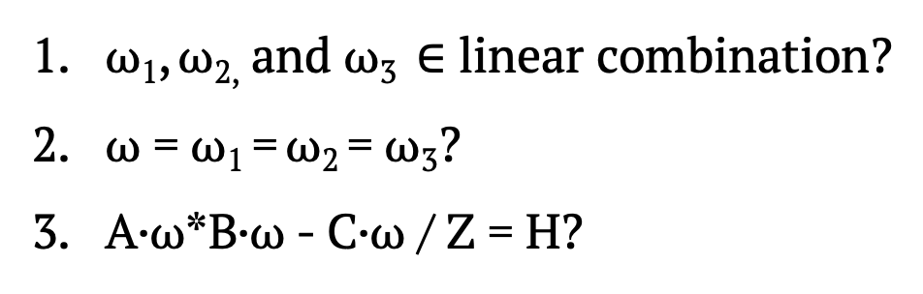
Verification
ω₁
ω₁
G * A₁(π), G * A₂(π), ...
G * B₁ (π), G * B₂ (π), ...
G * C₁ (π), G * C₂ (π), ...
G * A·ω₁(π) G * A·ω₁(π) *α
G * B·ω₂(π) G * B·ω₂(π) * β
G * C·ω₃(π) G * C·ω₃(π) * γ
G * A₁(π) * α, G * A₂(π) * α, ...
G * B₁ (π) * β, G * B₂ (π) * β, ...
G * C₁ (π) * γ, G * C₂ (π) * γ, ...
+
ω₂
ω₂
+
ω₃
ω₃
=
G * (A·ω₁ + B·ω₂ + C·ω₃)(π) G * (A+B+C)·ω(π) * δ
ω₁, ω_{2,} and ω₃ $∈$ linear combination?
ω = ω₁ = ω₂ = ω₃?
A·ω*B·ω - C·ω / Z = H?
e(G * A·ω₁(π), G * B·ω₂(π)) / e(G * C·ω₃(π), G) ?= e(G * H(π), G * Z(t))
: paring check

Slide 41
Groth16
An improvement of the Pinocchio protocol, mainly in the part of setup and verification.
Pros: short constant size of proving key.
Cons: circuit-specific trusted setup, requiring more strict security assumptions of bilinear mapping pairs.
Widely used in early anonymous coin projects such as ZCash.

Slide 42
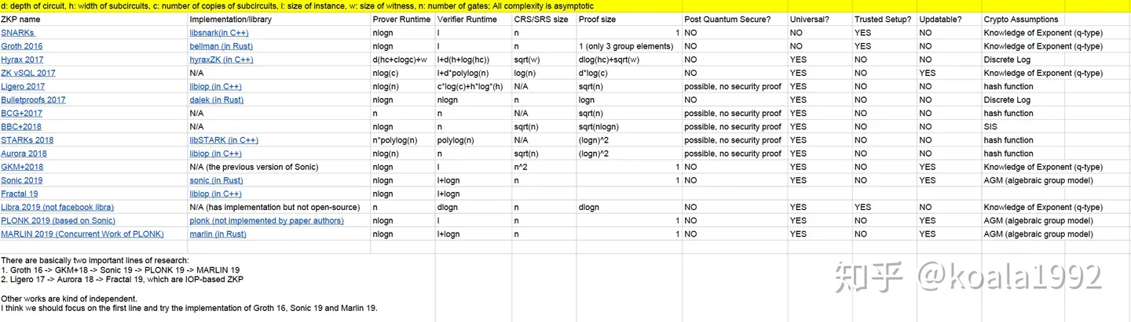
Comparison of Different zk-SNARKs
https://zhuanlan.zhihu.com/p/40245832

